Slide 1

Overview of English 3
SPEAKING & WRITING

Slide 2
COURSE ASSESSMENT
Attendance: 10%
+ 50% for full attendance (minus 1 point for missing class or skipping class, half point for being late or coming out late)
+ 30% for homework
+ 20% for classroom attitude
- Mid-term tests: 20% (Speaking test)
- Final test: 70%

Slide 3

COURSE INTRODUCTION
Course length:
45 periods = 3 credits = 15 lessons
Eligibility for final test:
+ attendance: ≥ 80%
+ both attendance and mid term test scores : ≥ 3

Slide 4

OVERVIEW OF ENGLISH 3 Final exam
TEST FORMAT:
Questions | Description
 | Write a sentence based on a picture
 | Respond to a written request
 | Multiple choice (grammar, vocabulary)

Slide 5
CHÚ Ý: Vào buổi học thứ 15, GV thông báo điểm Chuyên cần + Giữa kỳ cho SV. Có thắc mắc gì, SV cần phản hồi ngay trong buổi học cuối. Sau khi kết thúc học phần, GV không giải quyết vấn đề thắc mắc điểm nữa.
Để đủ điều kiện tốt nghiệp, SV sẽ tham dự kỳ thi chuẩn đầu ra Tiếng Anh.

Slide 6
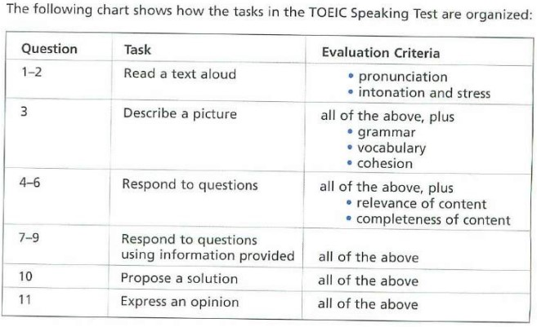
I. OVERVIEW OF TOEIC SPEAKING
11 questions

Slide 7
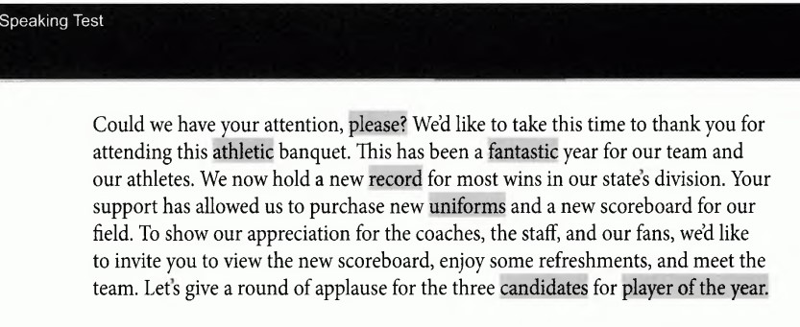


PARTS OF THE TOEIC SPEAKING TEST
Questions 1-2: Read a text aloud
A short text will appear on the screen. You will then have 45 seconds to look it over and get ready to speak. After that, you will have 45 seconds to read the text aloud.
You will be evaluated on
Pronunciation
Intonation and stress

Slide 8
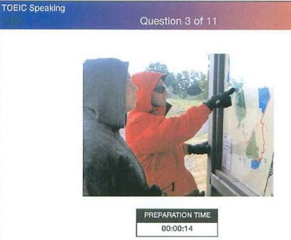
Question 3: Describe a Picture
P.29
For Question 3, you will describe a photo with as much detail as possible. A photo will appear on the screen. You will have 30 seconds to look it over and get ready to respond. Then you will have 45 seconds to talk about the photo.
You will be evaluated on
Pronunciation
Intonation and stress
Vocabulary
Grammar
Cohesion of ideas

Slide 9
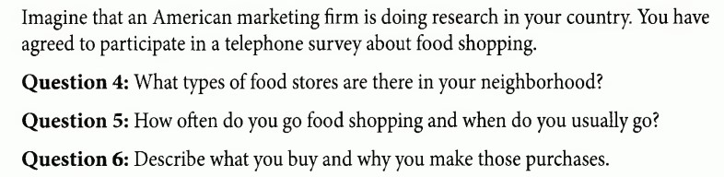

Questions 4-6: Respond to Questions
p.39
Questions 4-6 test your speaking skills about personal experiences and familiar topics. There is no preparation time allowed.
You will be evaluated on
Pronunciation
Intonation and stress
Vocabulary
Grammar
Cohesion of ideas
Completeness of content
Relevance of content

Slide 10
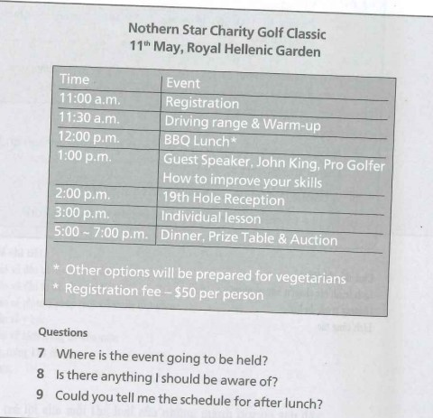
Questions 7-9: Respond to Questions Using Information Provided
You will answer three questions about information that will be provided to you.
Evaluations
as questions 4-6
You will be evaluated on
Pronunciation
Intonation and stress
Vocabulary
Grammar
Cohesion of ideas
Completeness of content
Relevance of content

Slide 11
p.69
Question 10: Propose a Solution
For Question 10, you will hear a voicemail message about a problem and you will be asked to propose a solution in a voicemail reply. You will only hear the problem; it will not appear on the screen. After you hear the problem, you will have 30 seconds to get ready, and then you will have 60 seconds to respond. You will have to understand the problem the speaker is describing, come up with a reasonable solution, and then describe your solution out loud.
Evaluations
as questions 4-6
You will be evaluated on
Pronunciation
Intonation and stress
Vocabulary
Grammar
Cohesion of ideas
Completeness of content
Relevance of content

Slide 12
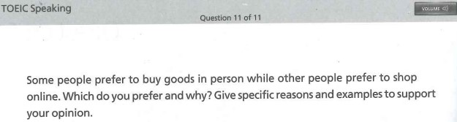
p. 84
Question 11: Express an Opinion
In Question 11, you will be asked to state your opinion about a topic. You will be asked to agree or disagree with a statement, explain a preference, or discuss your opinion of a situation. The question will appear on-screen and will be read by a narrator. You will have 15 seconds to prepare your response and 60 seconds to speak.
You will be evaluated on
Pronunciation
Intonation and stress
Vocabulary
Grammar
Cohesion of ideas
Completeness of content
Relevance of content
Evaluations
as questions 4-6

Slide 13
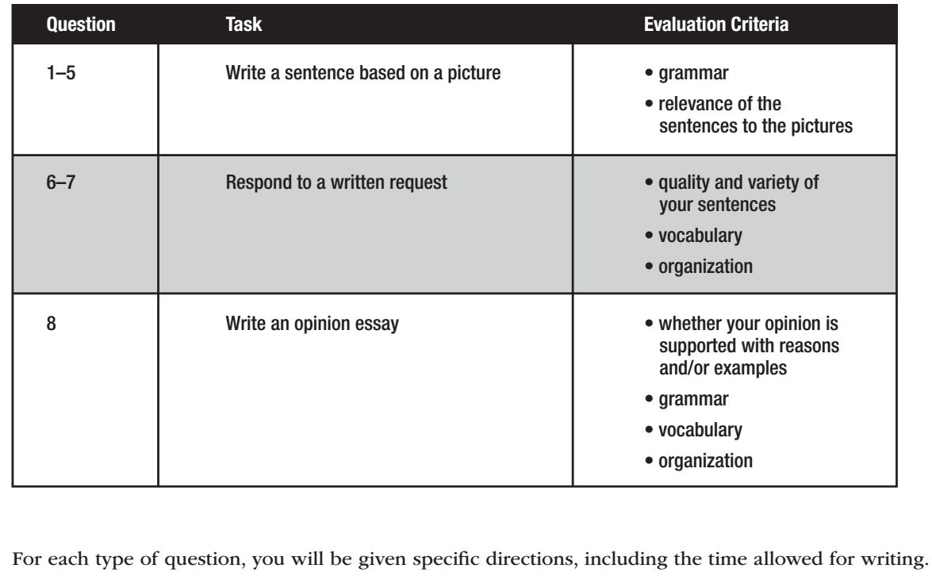
OVERVIEW OF TOEIC WRITING TEST

Slide 14

Questions 1-5: Write a Sentence Based on a Picture
p. 108
For each of Questions 1-5, you will see a photo accompanied by two words or phrases. You will write a sentence about the photo using the two words or phrases provided
Merchandise
supermarket

Slide 15
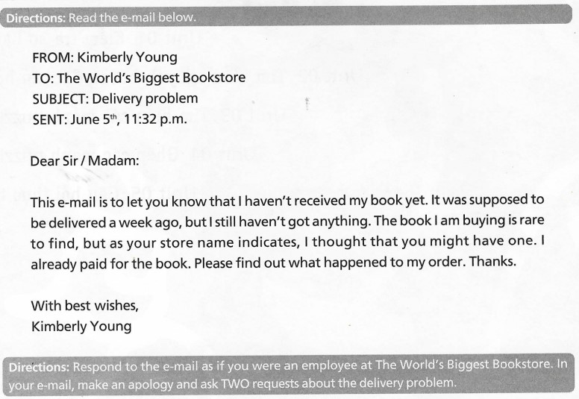
Questions 6-7: Respond to a written request p.124
For Writing Questions 6 and 7, you will read an e-mail and respond to it. The e-mails may deal with topics such as: Office issues, Orders and shipments, Job ads and applications, Schedules, Ads for products and services, Appointments.
Work in groups: write an email to respond to this email

Slide 16

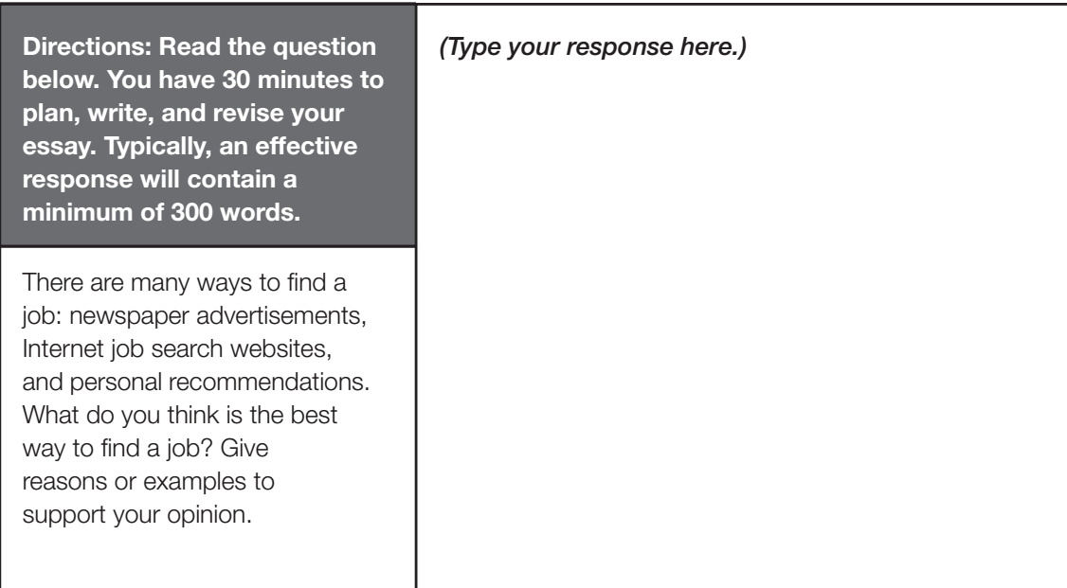
Questions 8: Write an opinion essay p.140
For Writing Questions 8: In this part of the test, you will write an essay in response to a question that asks you to state, explain and support your opinion on an issue. Typically, an effective essay will contain a minimum of 300 words.

Slide 17
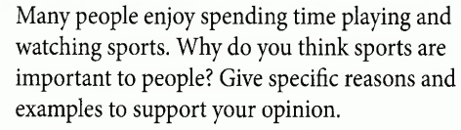
PRACTICE QUESTION 8
In groups, make an outline for the following questions

Slide 18
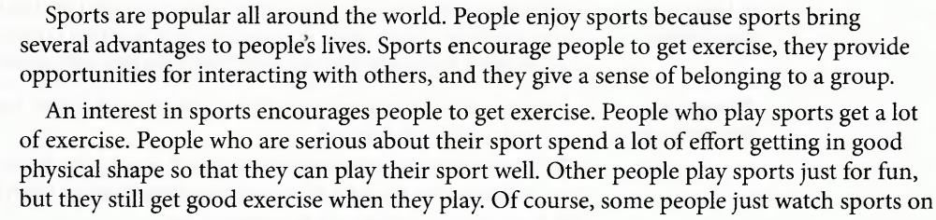
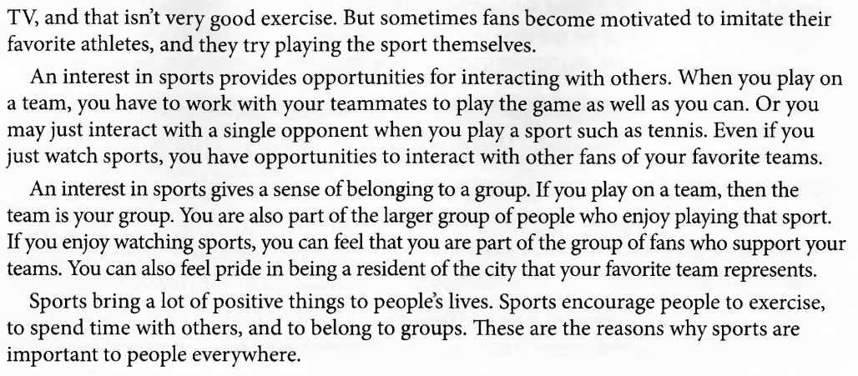
SAMPLE RESPONSE

Slide 19


HOMEWORK
Describe the pictures orally (at least 5 sentences per picture) and then write a sentence using 2 provided words to describe each picture.
guard/ checking
colleagues/ together

Slide 20


write/ glasses
carry/ hard hat

Slide 21


man/ phone
salesman/ key

Slide 22


men/ fishing
together / table

Slide 23


sit/ chat
near/tree

